Slide 1
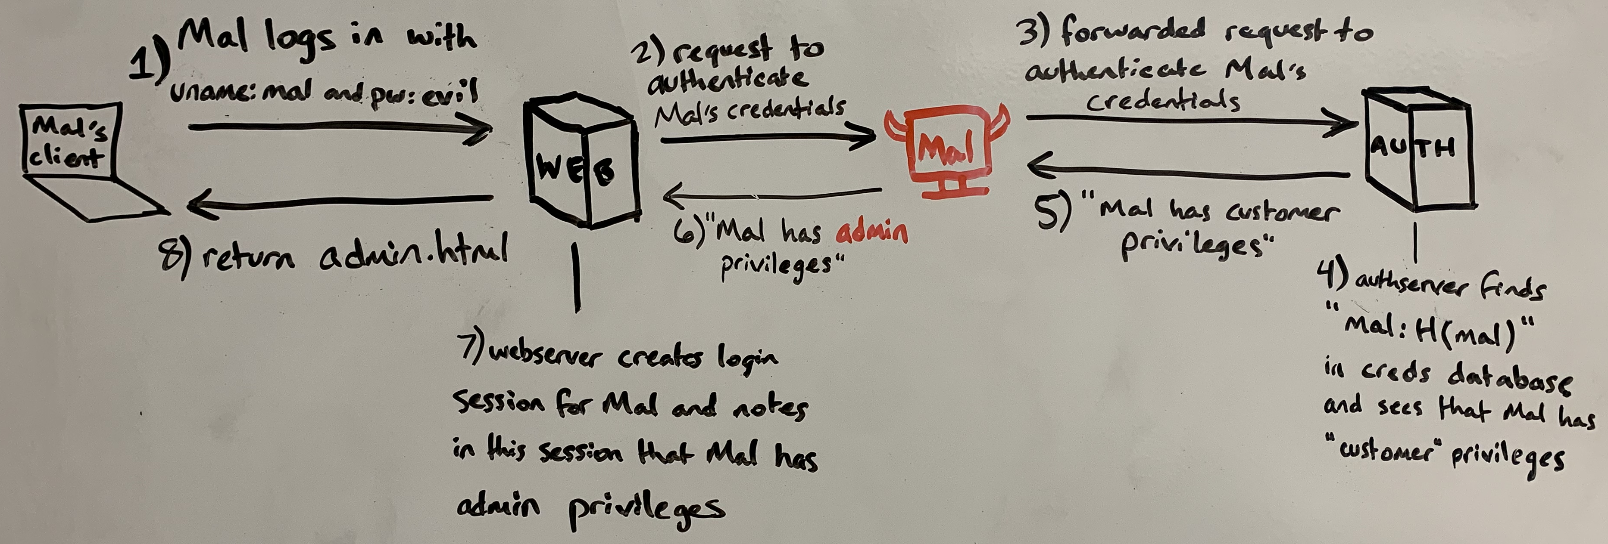


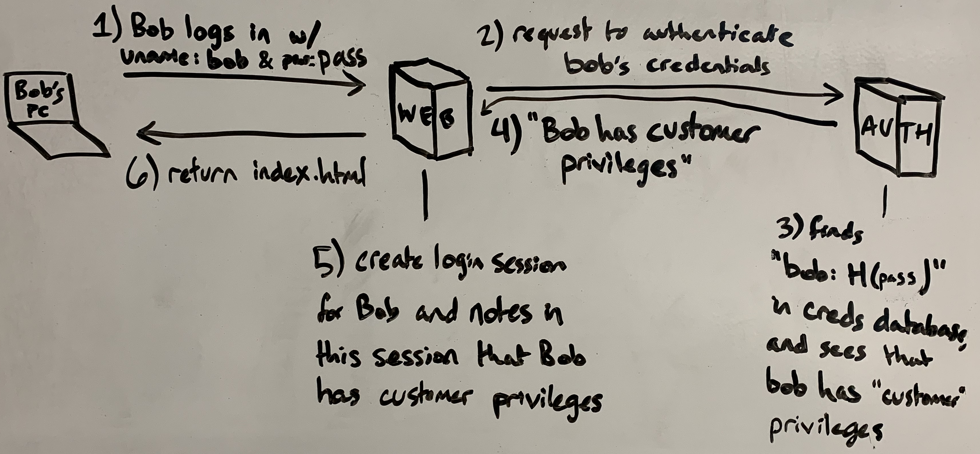
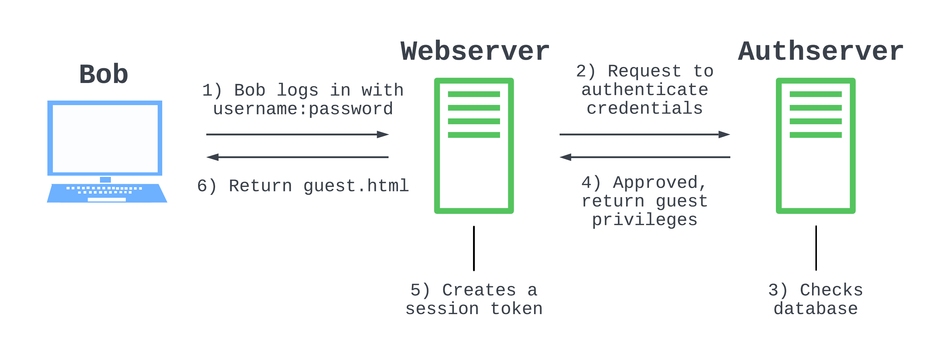
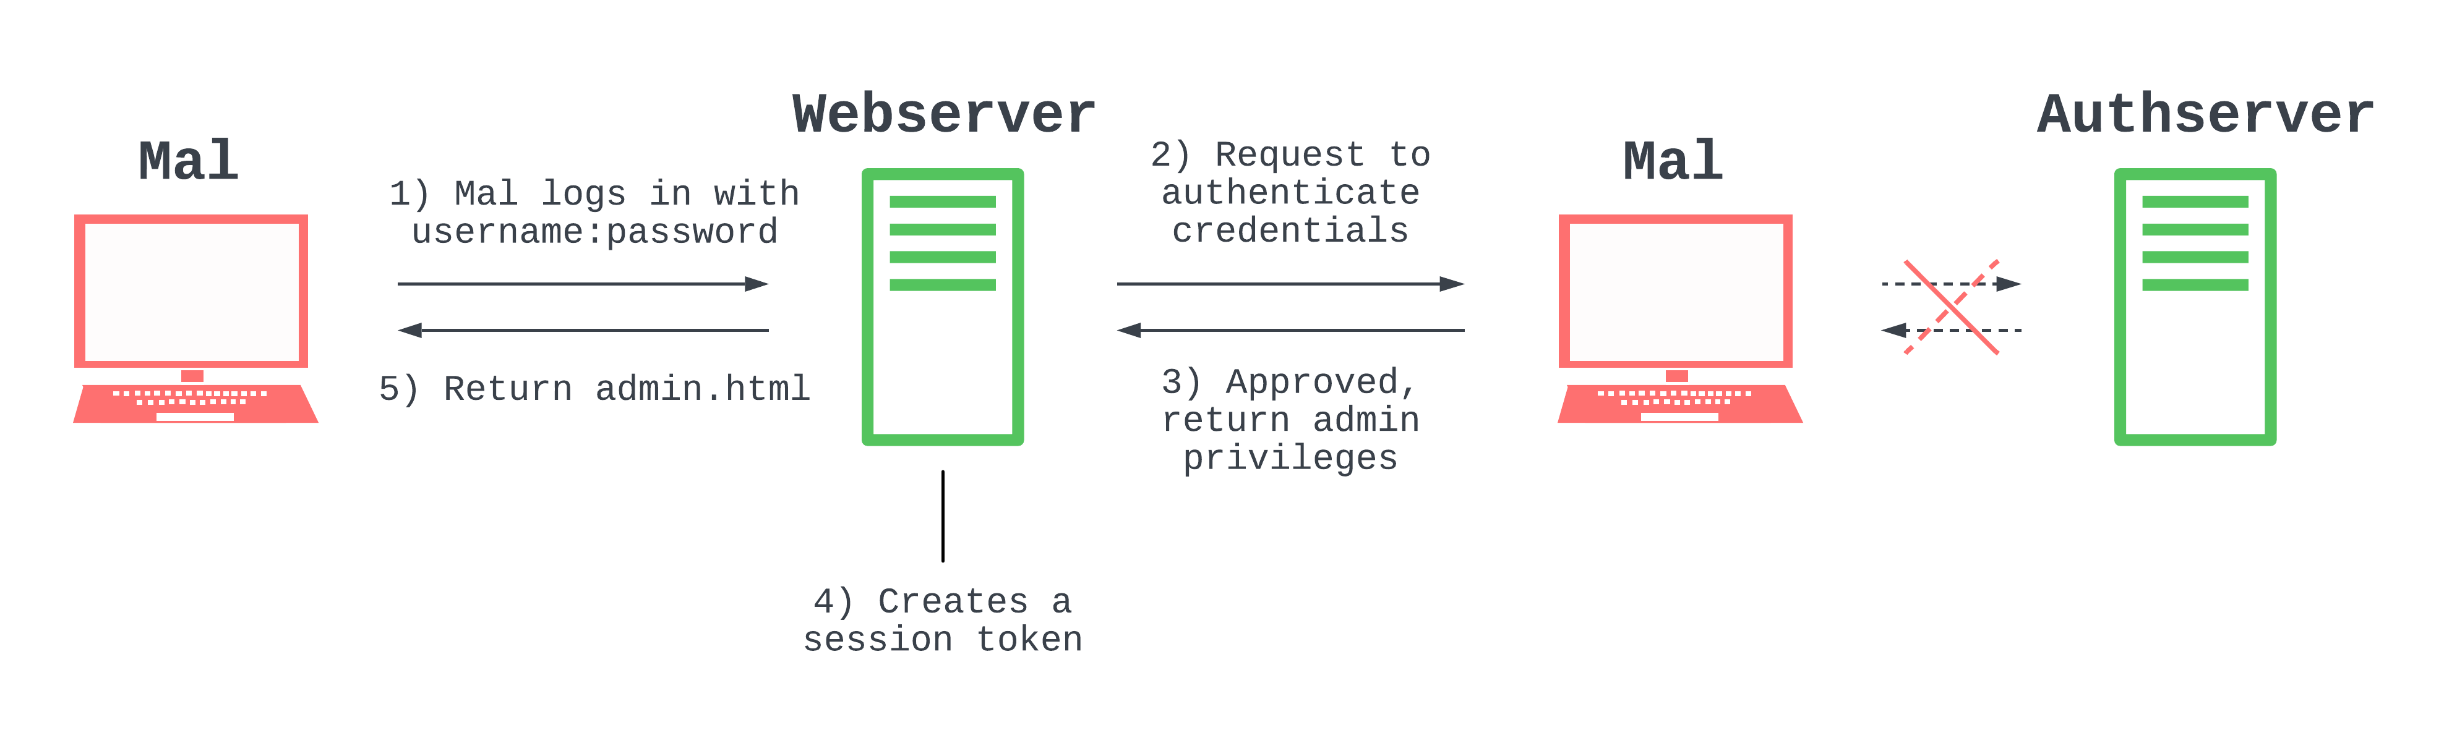
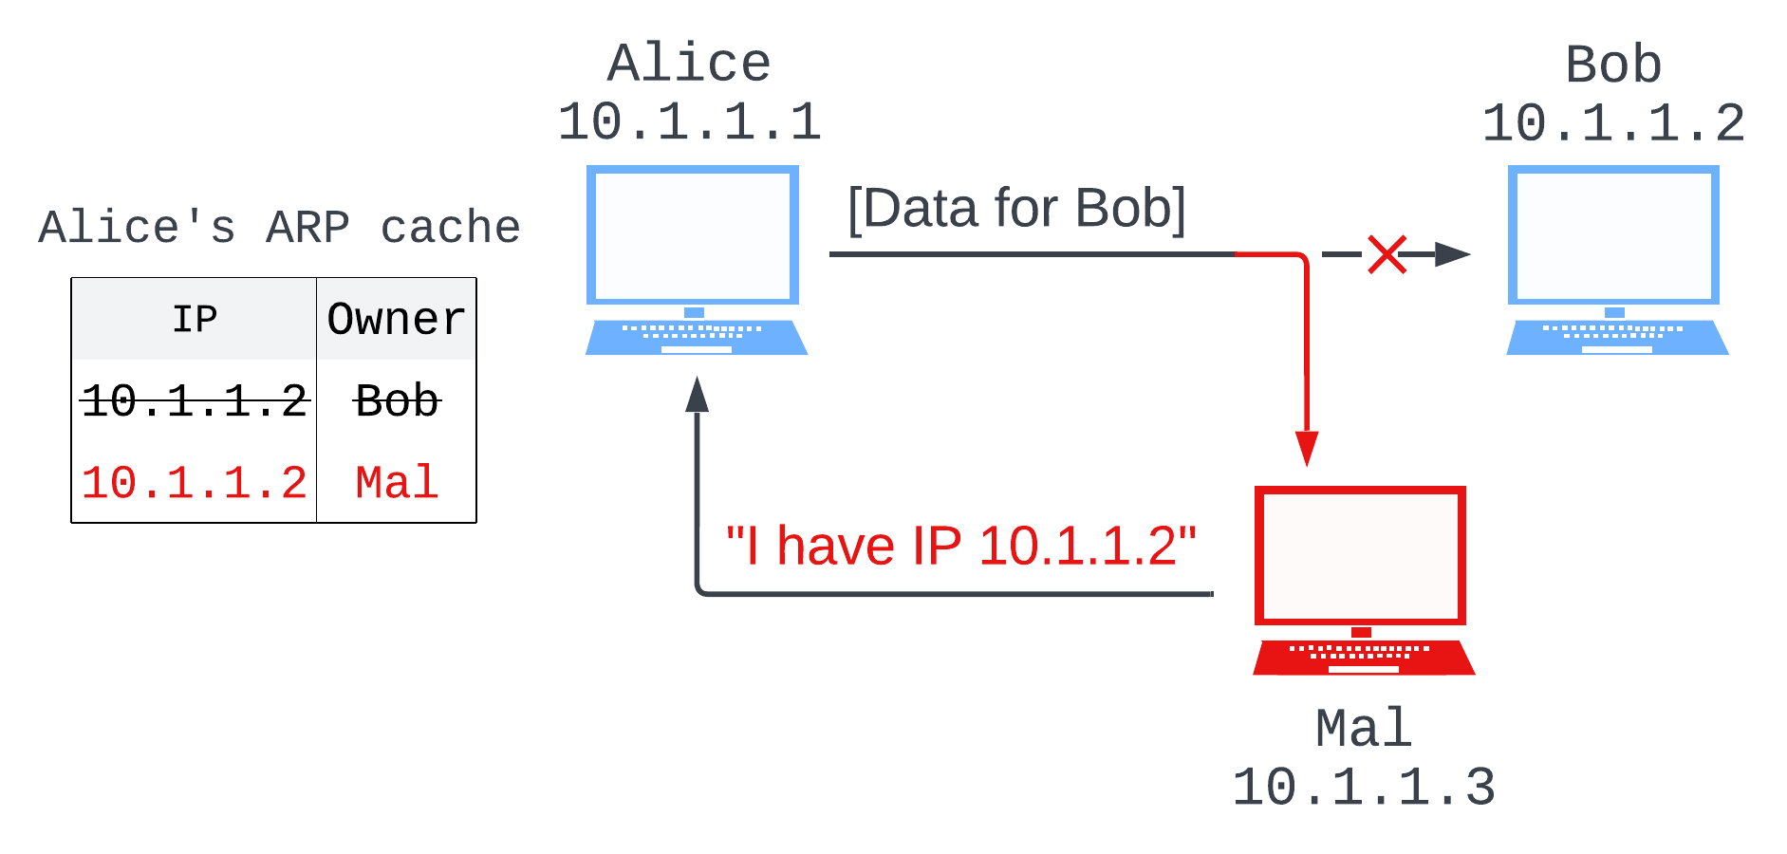
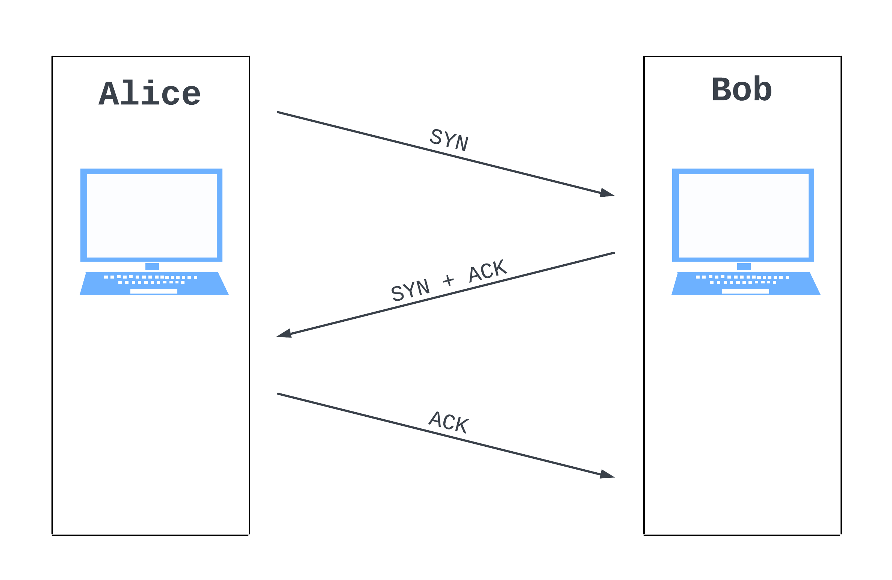
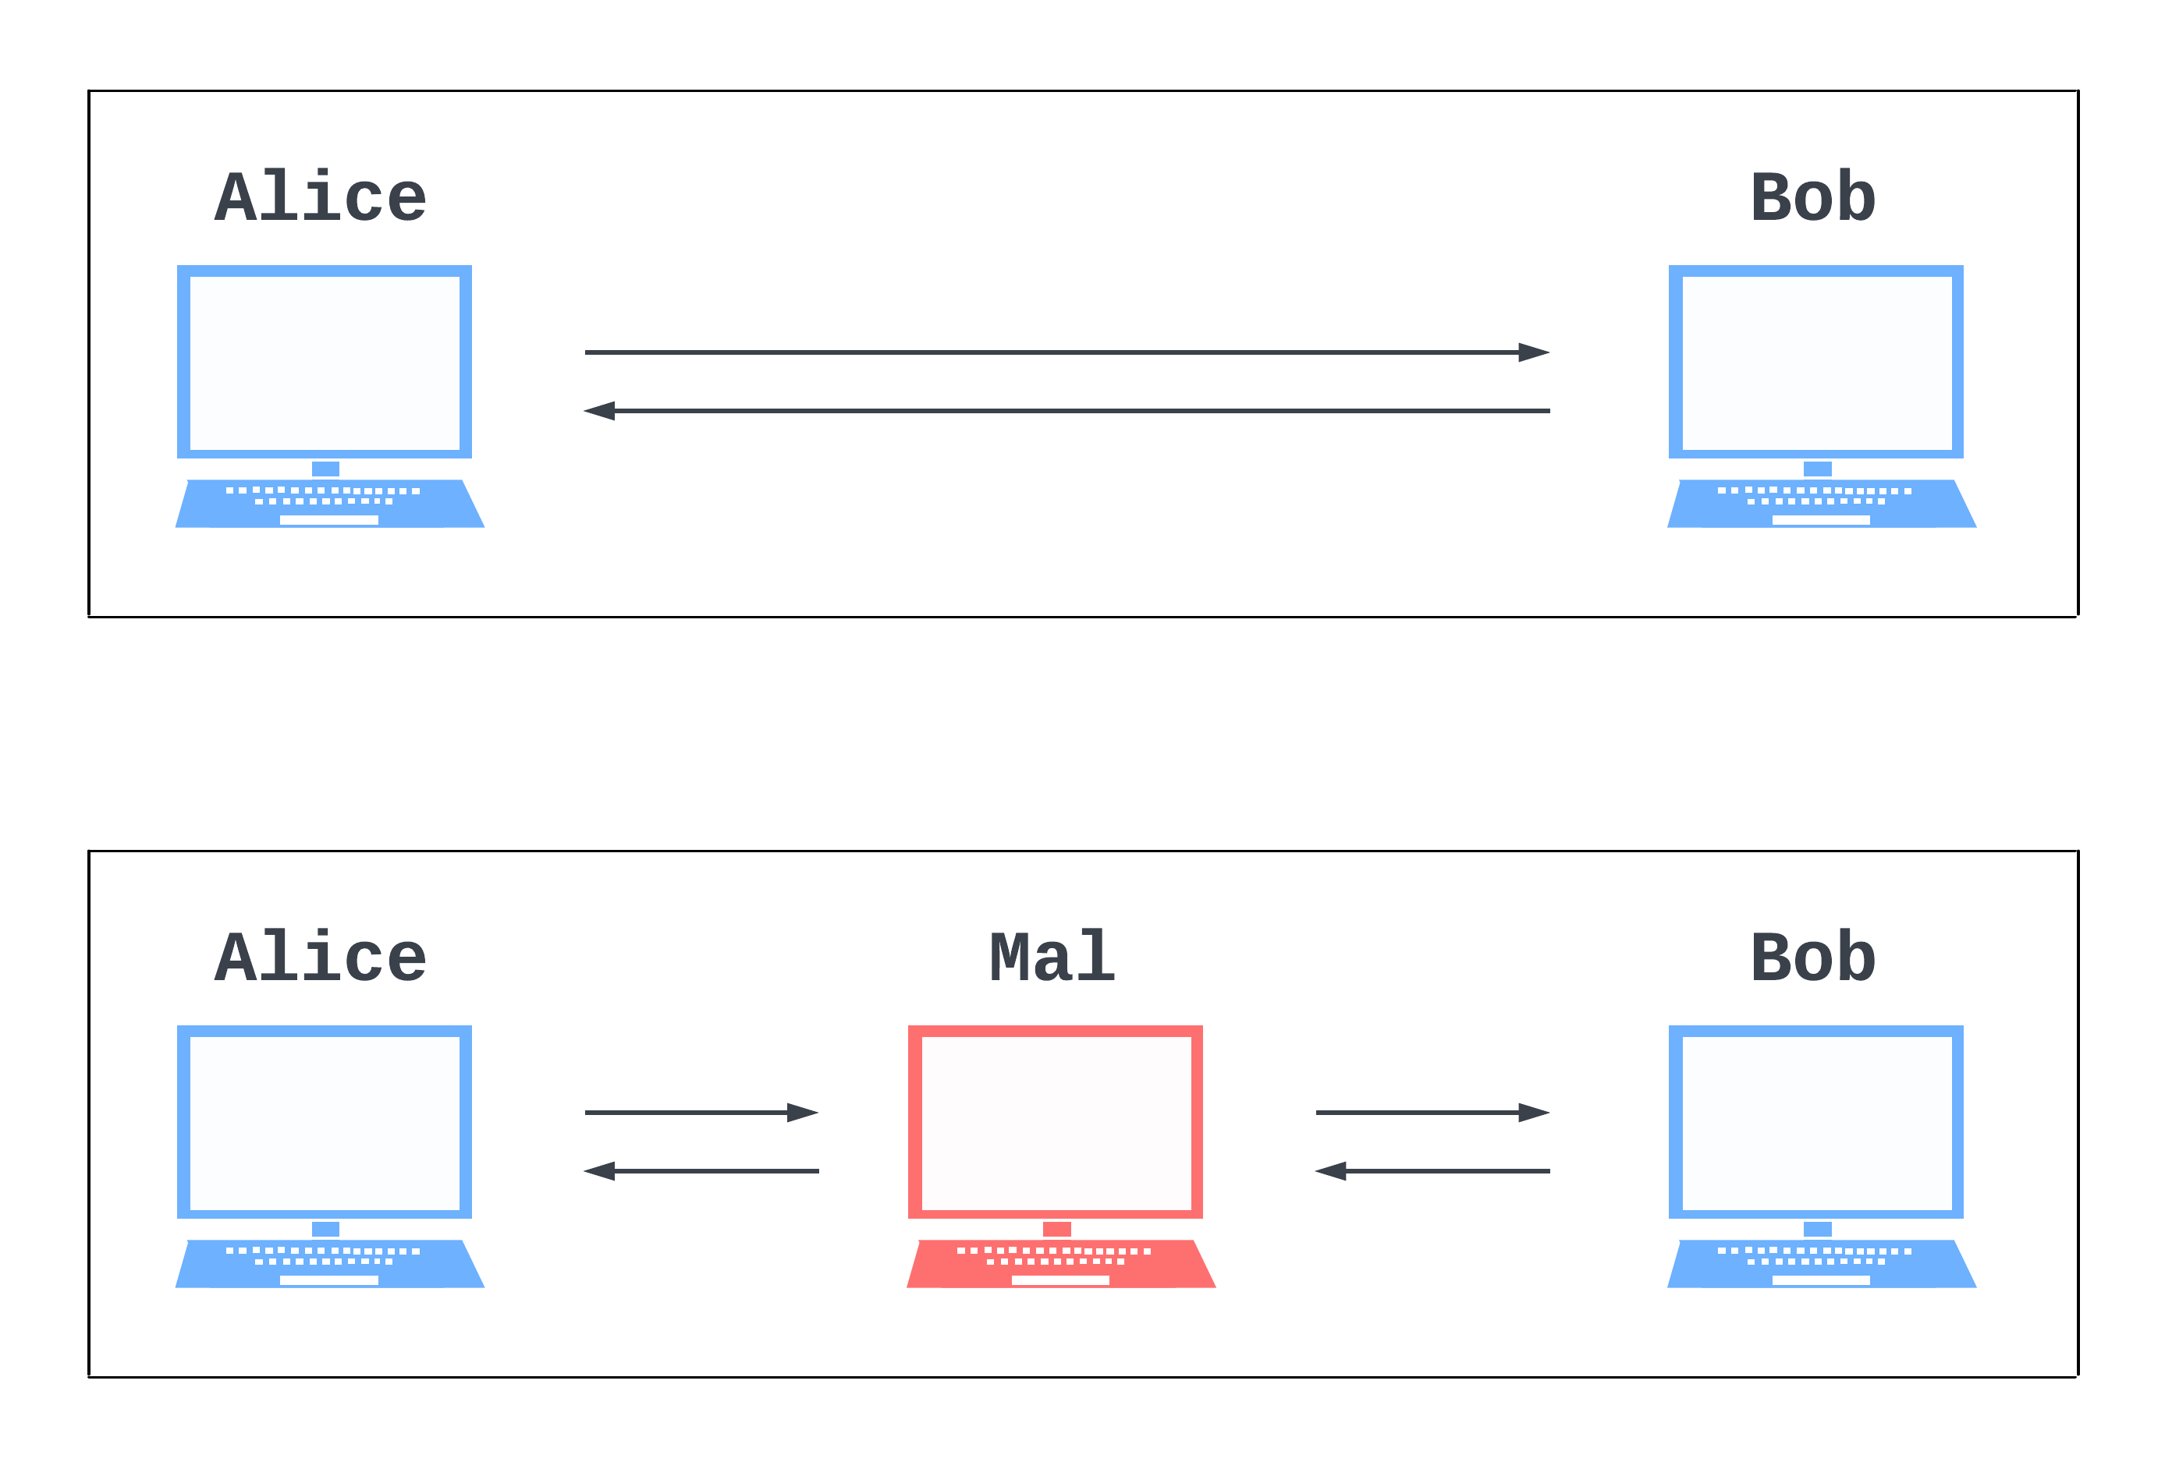
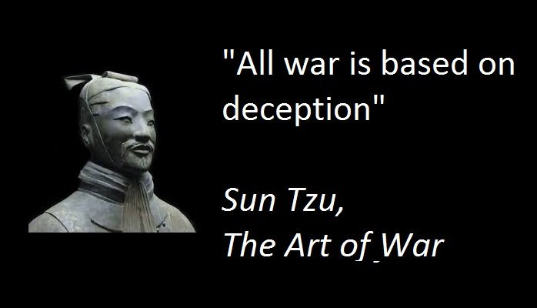
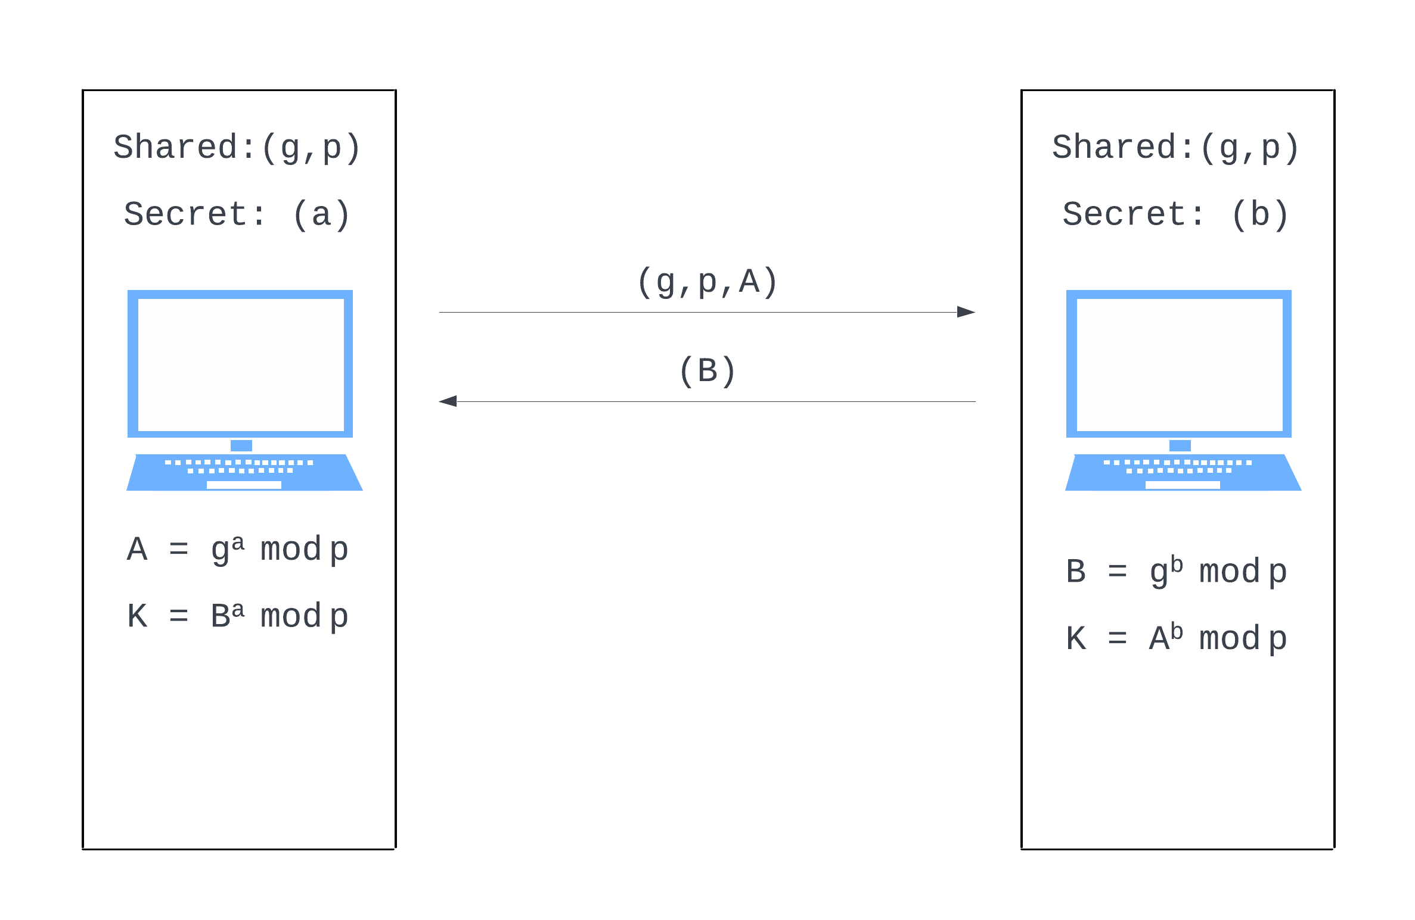
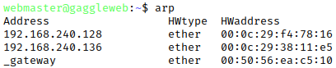
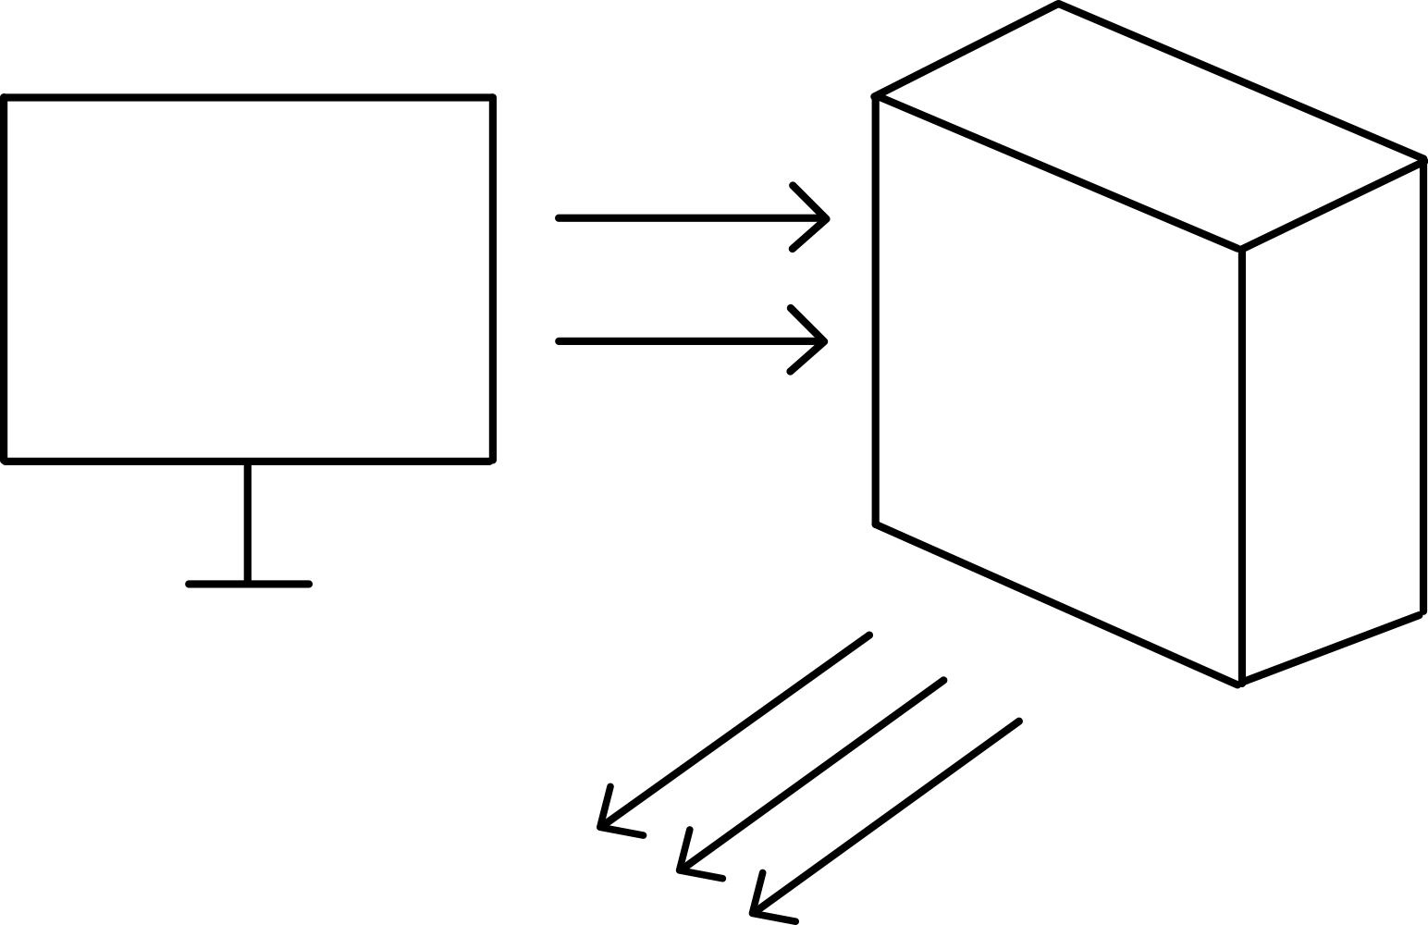
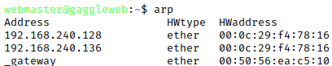

The ARP of War
Cole Weinstein, Robbie Young
References
System Setup
Attack Vector
ARP Poisoning
Denial of Service (DoS)
Adversary in the Middle (AITM)
ARP Cache: connects IP and hardware addresses
ARP Poisoning: lying about controlling an IP address to other machines on the network
Used by an attacker to insert themselves between two computers and read/edit their data
[Could have exactly one more line of text here]
Regular webserver ARP cache
Poisoned webserver ARP cache
Denial of Service: overwhelm a victim server with traffic to prevent it from providing its services to clients
Application-layer attacks make simple requests that require long responses
Protocol attacks exploit lower-level Internet protocols, overwhelming the server’s network systems
Volumetric attacks flood a server with long requests, consuming the server’s bandwidth
Adversary in the Middle: an attacker places themselves between two communicating parties
Victims will continue to believe they’re talking over a direct connection
The attacker is able to eavesdrop on all data going between the two victims, and can modify the communications as they wish
Symmetric Encryption: using a secret key and some math, scramble your data in a way that only other people with the key can unscramble and read it
The TCP Handshake
Client: SYN packet – “Hi! Can we talk?”
Server: SYN, ACK packet – “Hello! Yes, we can talk.”
Client: ACK packet – “Great.”
Perceived Connection
Actual Connection
Diffie-Hellman as a way to create shared secrets
Something something, Diffie-Hellman vulnerable to AITM
TCP SYN Flood
Exploits the TCP Handshake
Attacker sends a bunch of SYN packets, but never responds to the server’s SYN-ACK
Server left storing garbage data for each half-open connection

